Slide 1
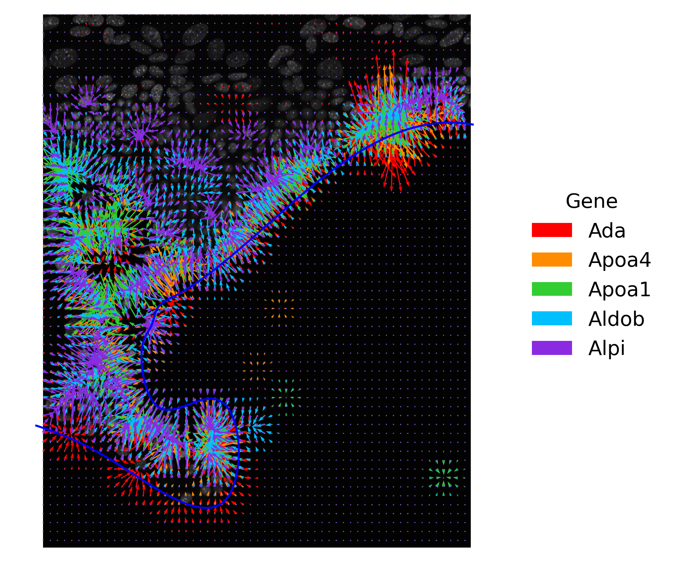
Quantifying Intestinal Zonation with Spatial Transcriptomics
Madison Wahlsten
10/6/2023

Slide 2
Can we examine spatial trends without considering cells?
1. Crop (ease of processing) + Gaussian smoothing +
Contrast enhancement

Slide 3
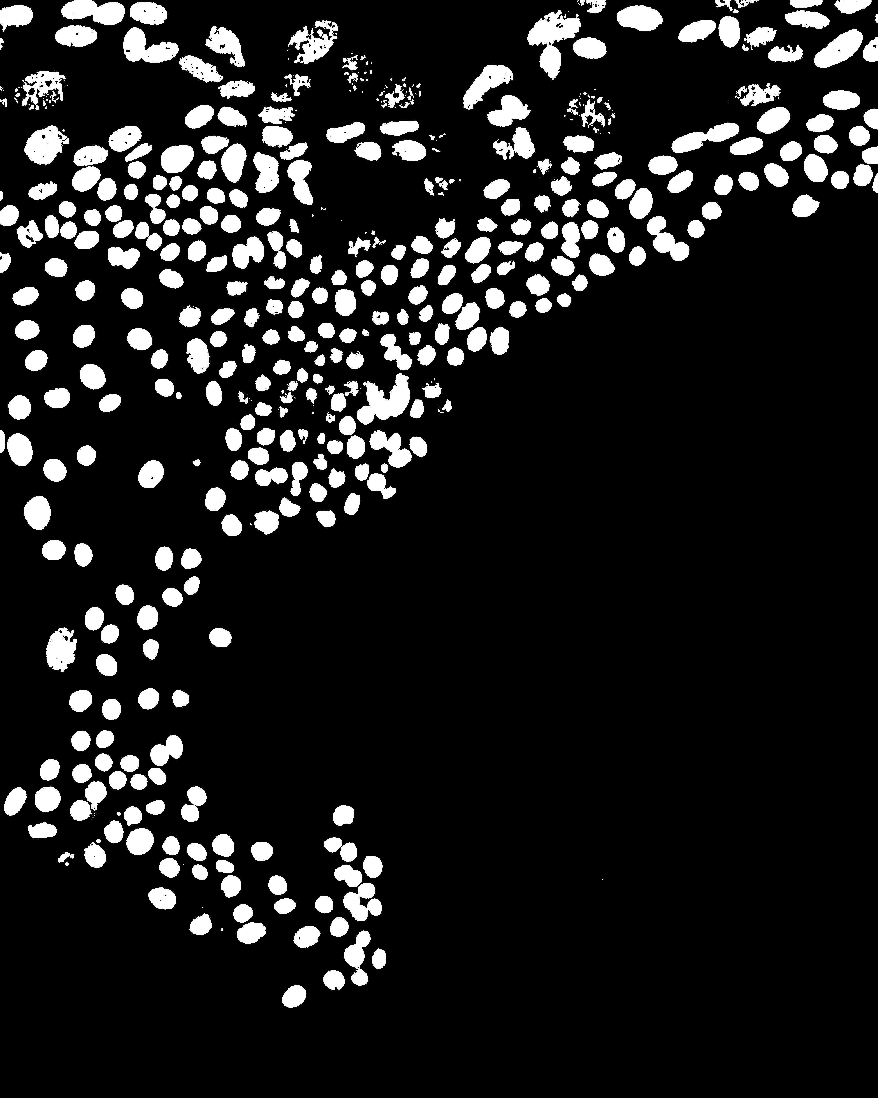
Another angle: Can we examine spatial trends without considering cells?
1. Crop (ease of processing) + Gaussian smoothing +
Contrast enhancement
2. Binarize

Slide 4

Another angle: Can we examine spatial trends without considering cells?
1. Crop (ease of processing) + Gaussian smoothing +
Contrast enhancement
2. Binarize
3. Dilate to form neighborhood structures for edge detection

Slide 5
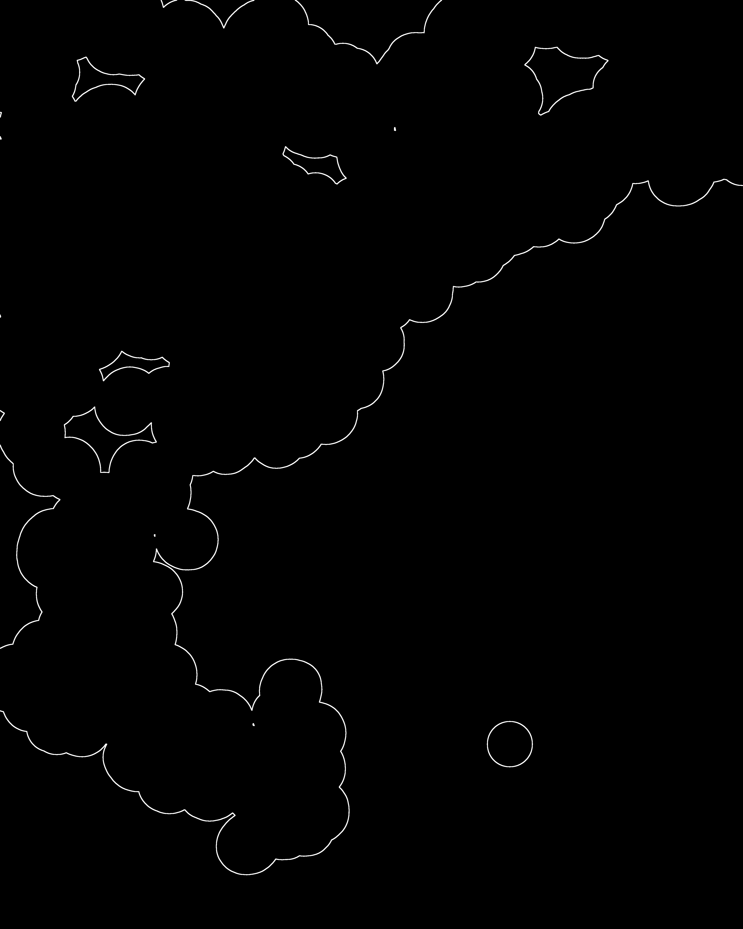
To examine spatial trends without considering individual cells, we can look at contours
4. Edge detection by eroding binary image and subtracting from original binary image

Slide 6
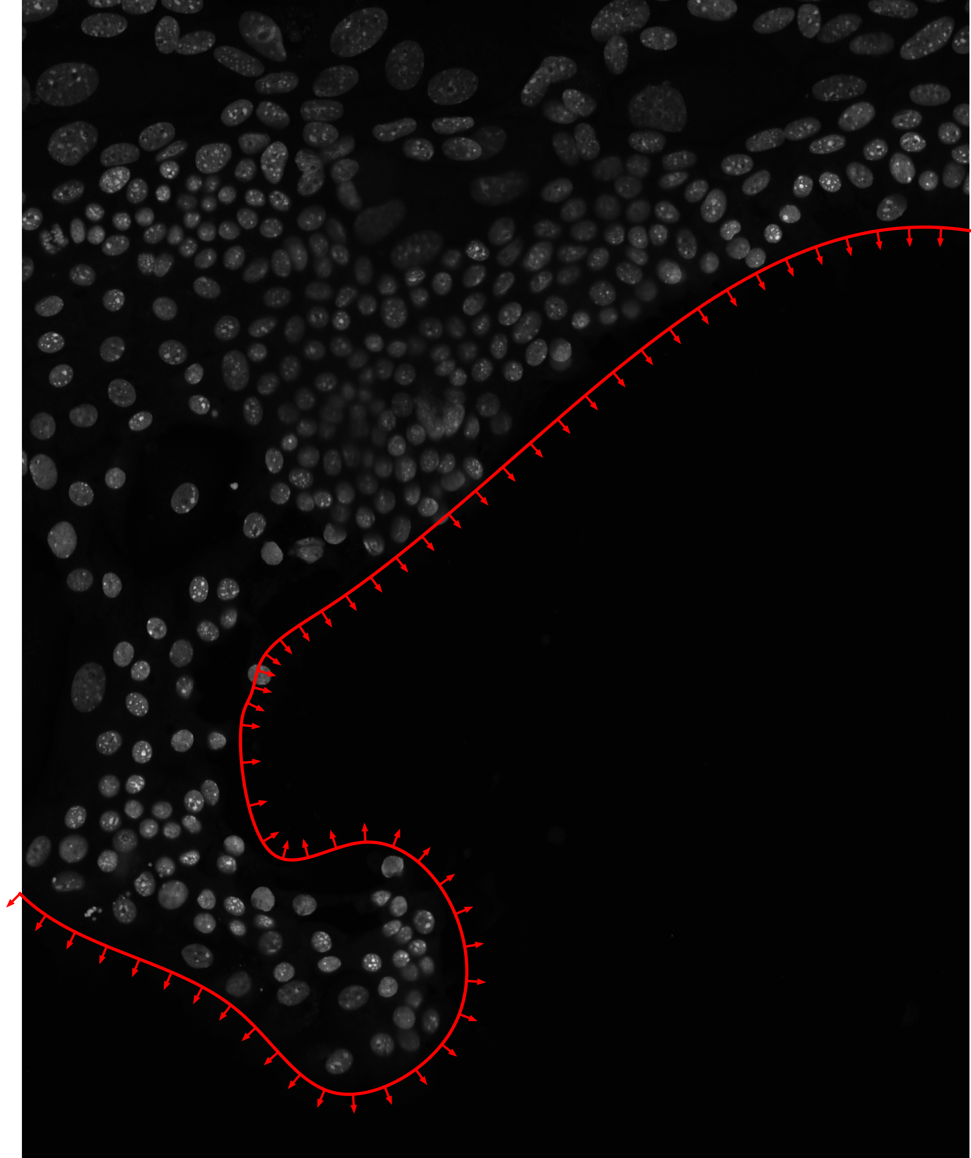
To examine spatial trends without considering individual cells, we can look at contours
4. Edge detection by eroding binary image and subtracting from original binary image
5. Contour detection to find lines and (smoothed) spline calculation

Slide 7
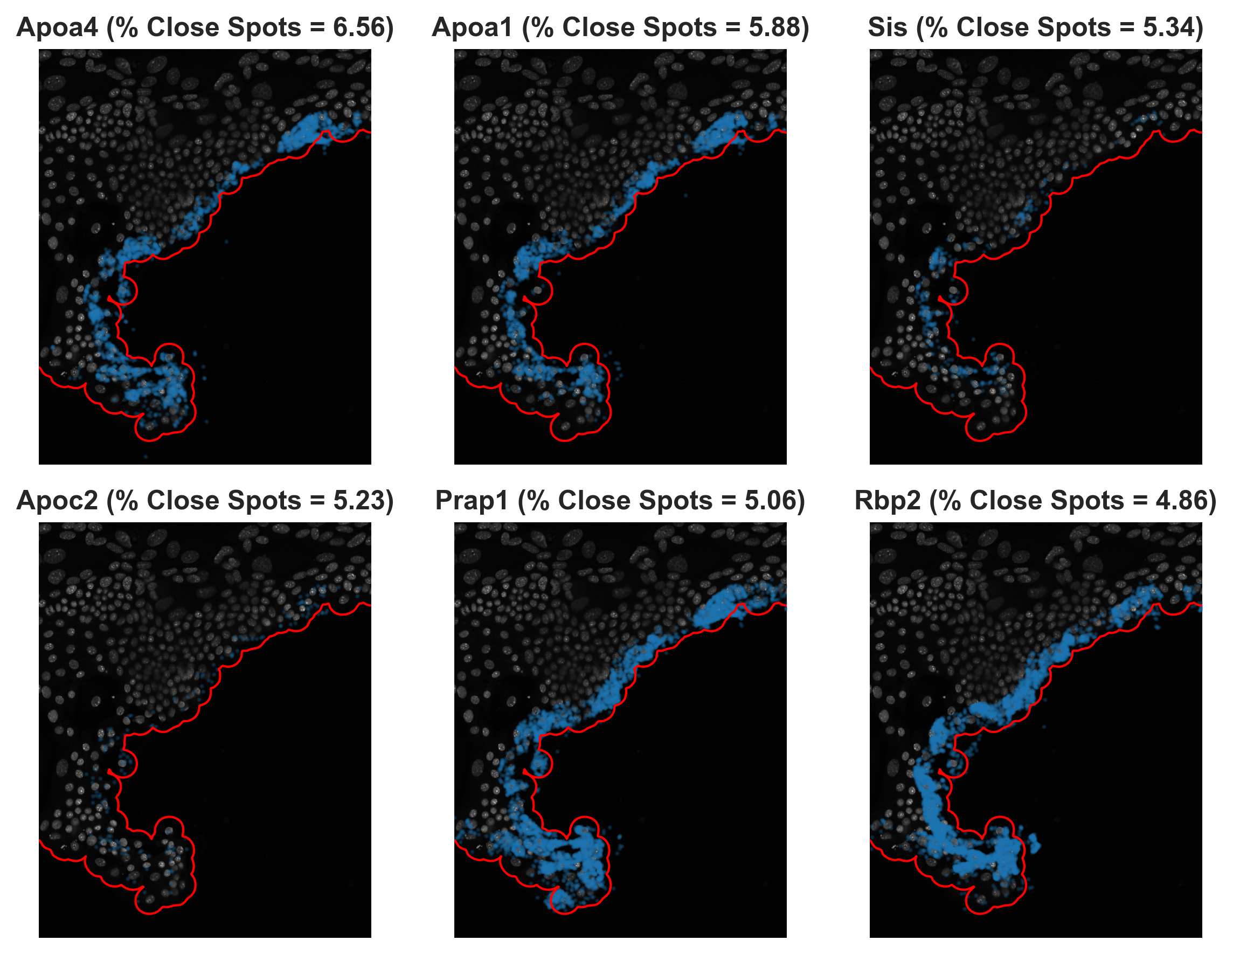
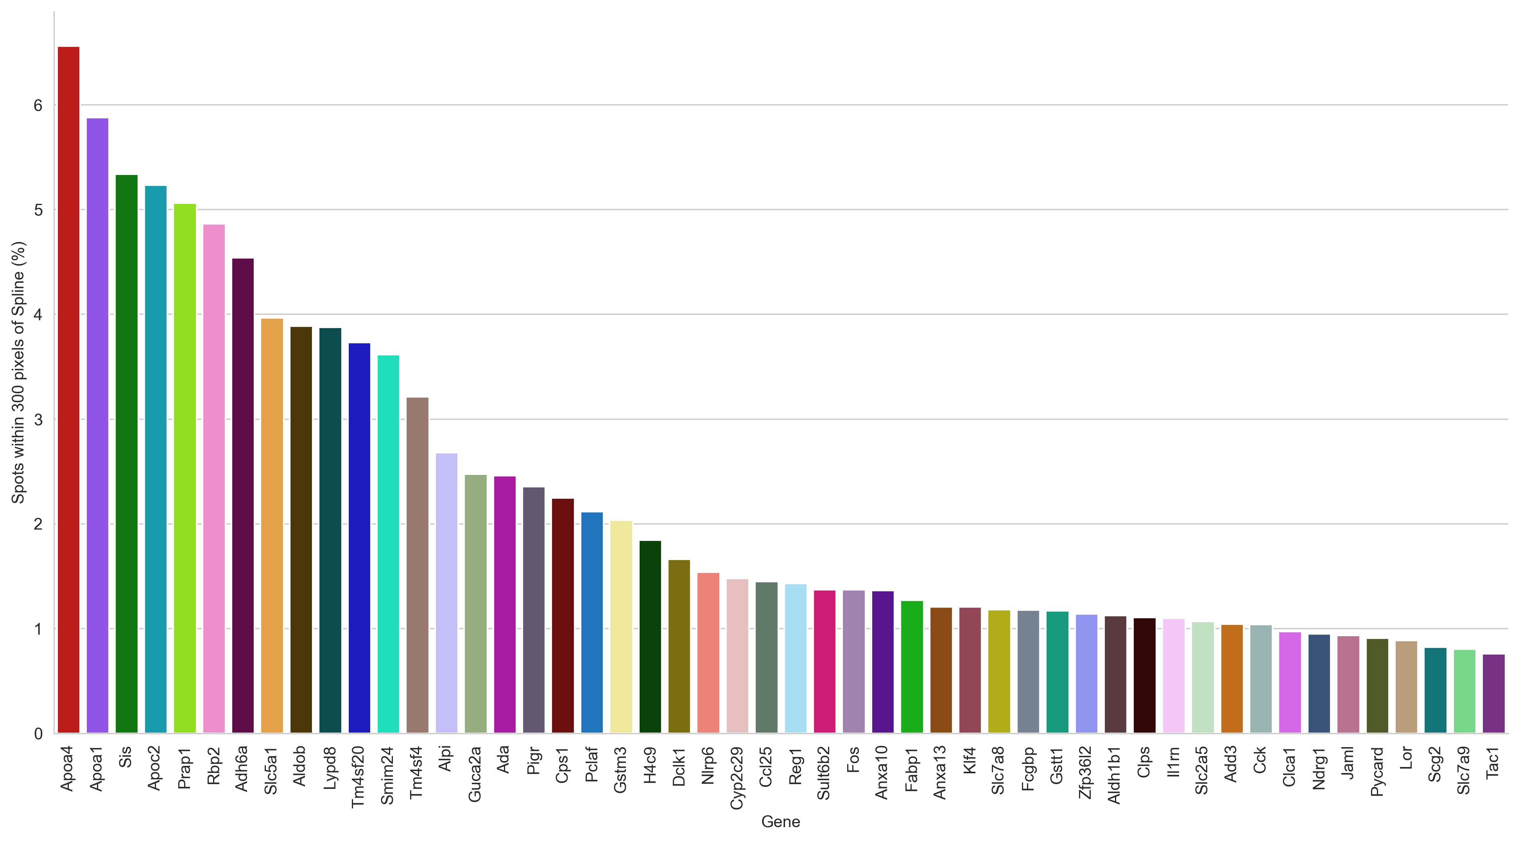
Quantifying spots in space by % of spots within 300 pixels of spline

Slide 8
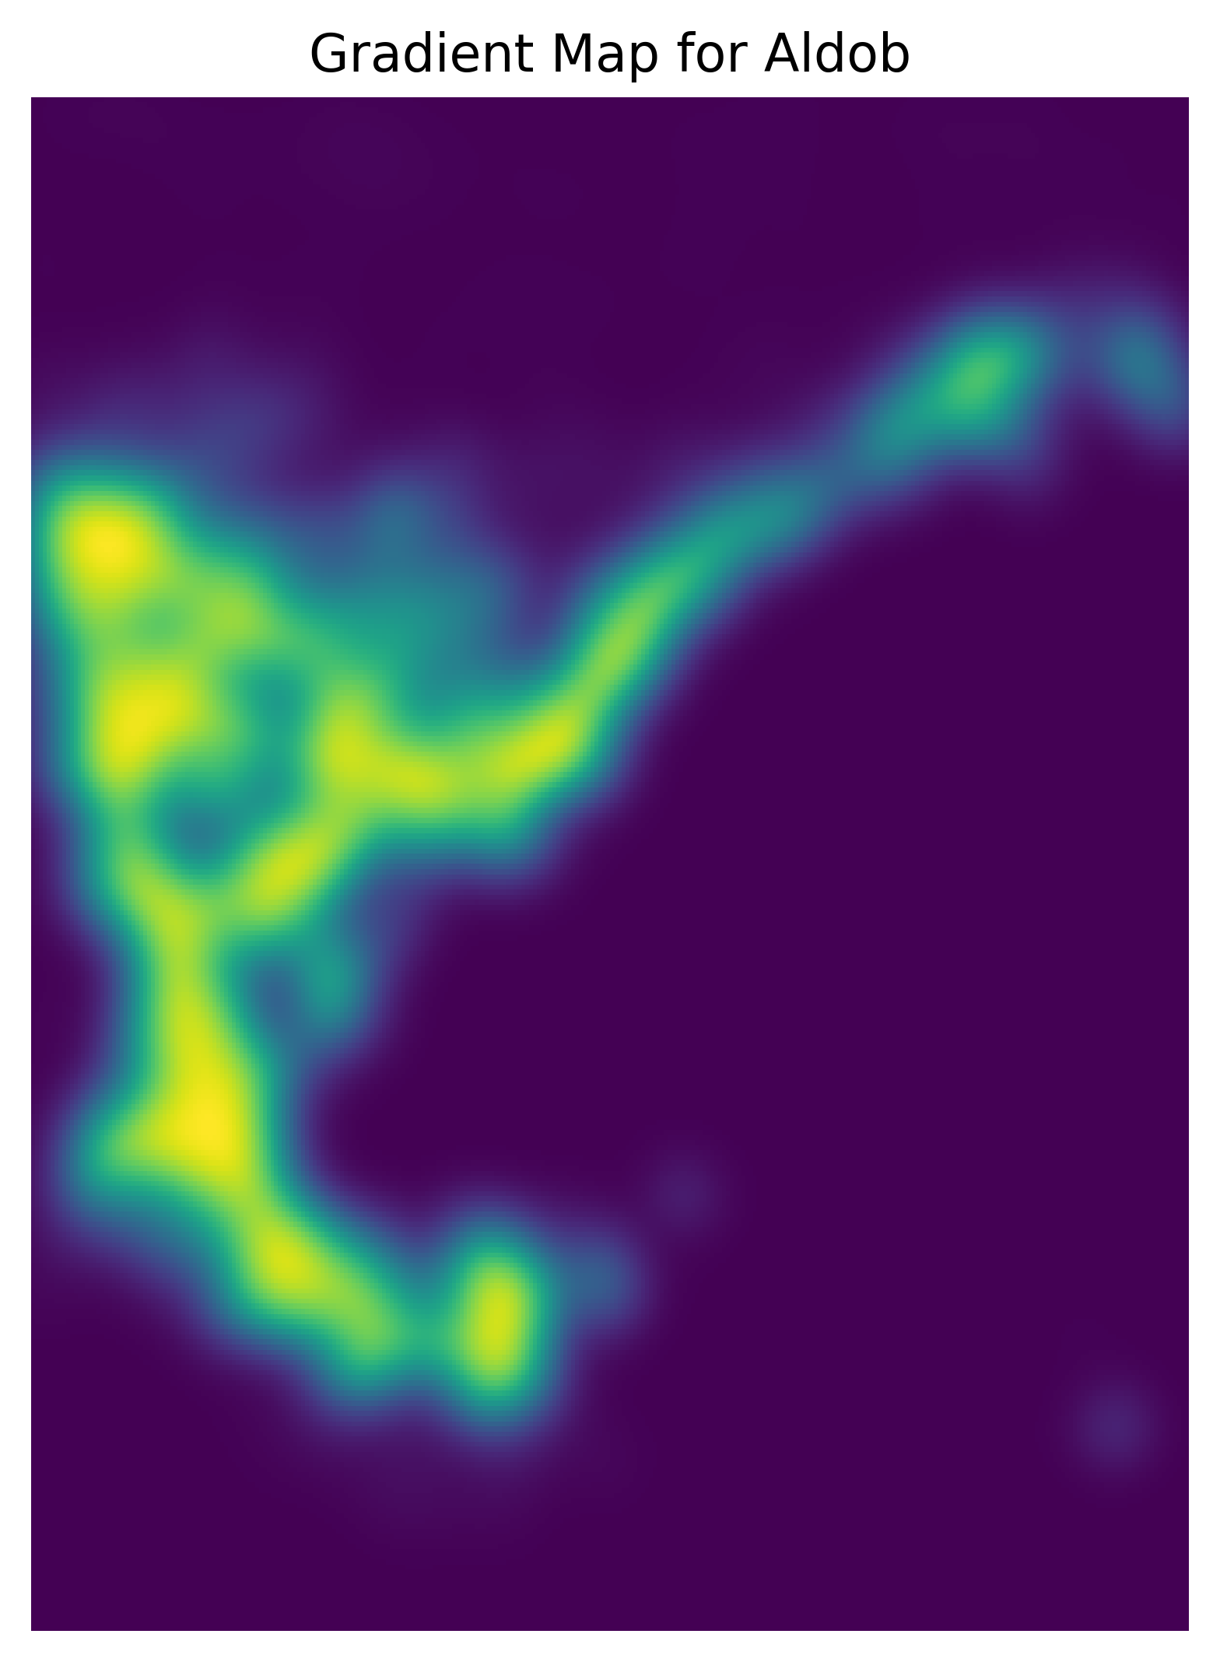
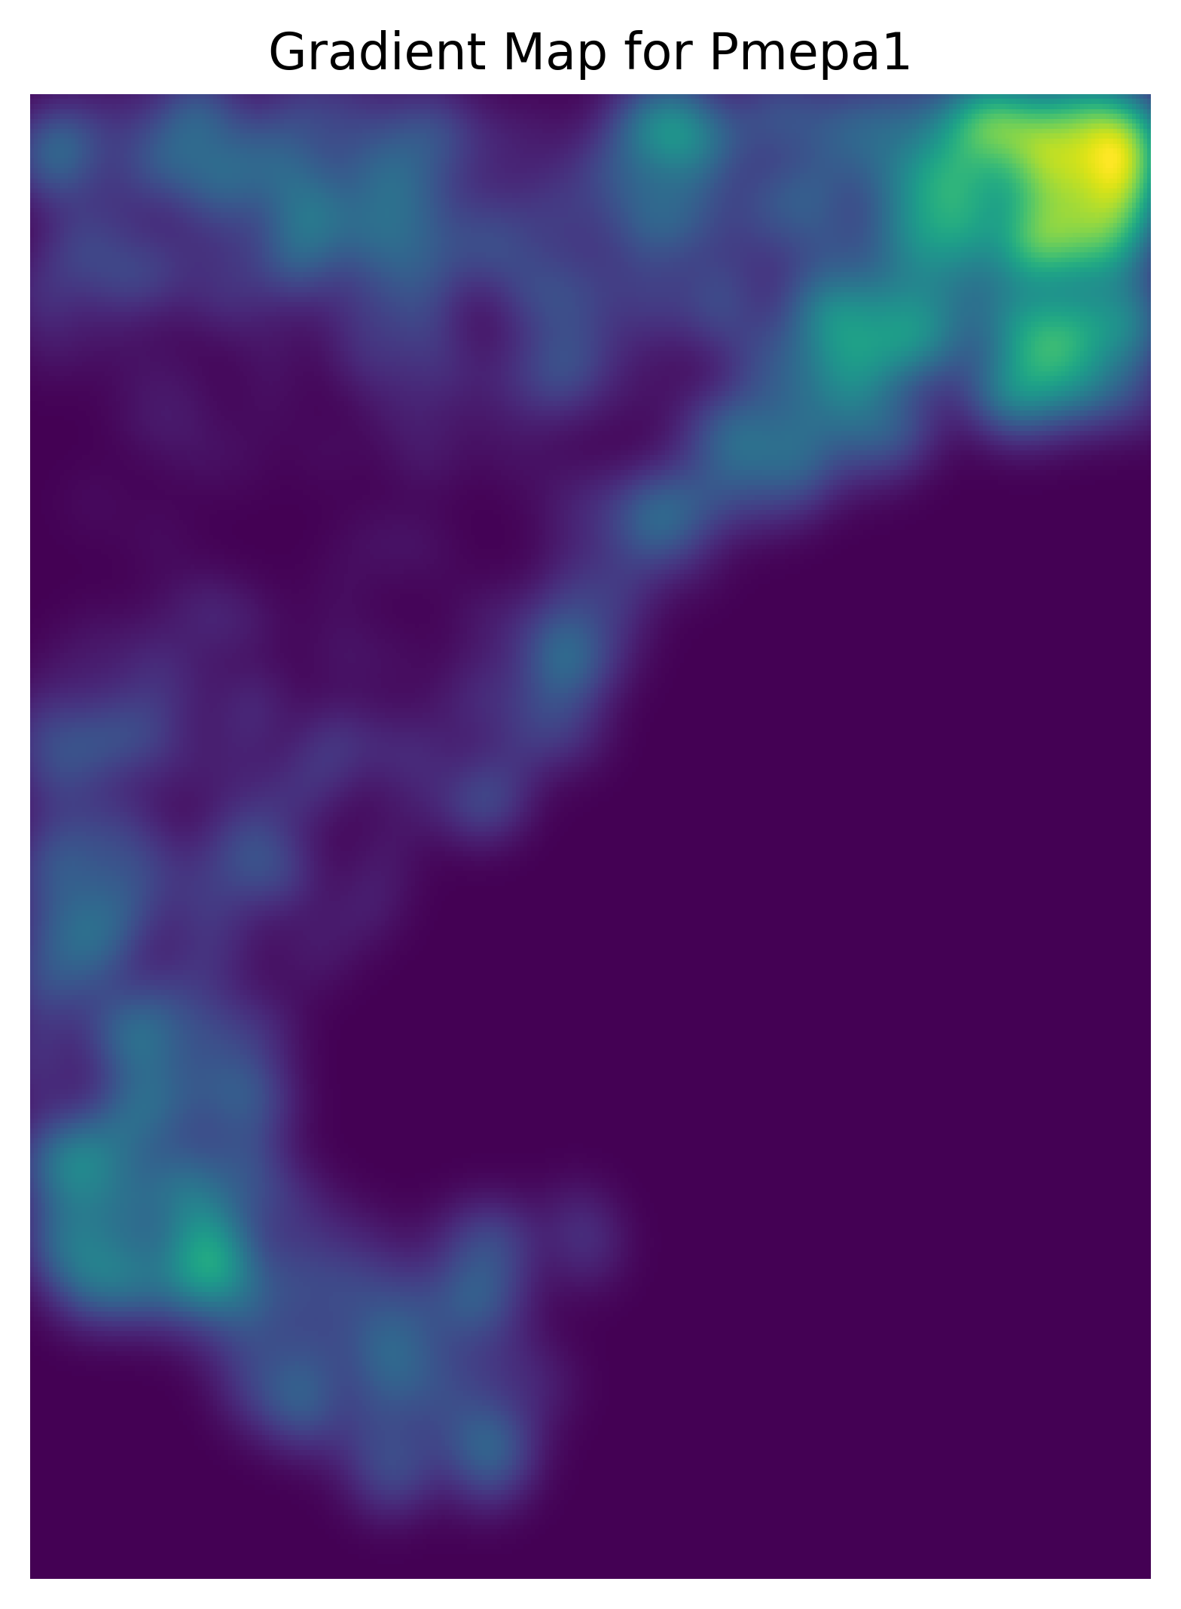
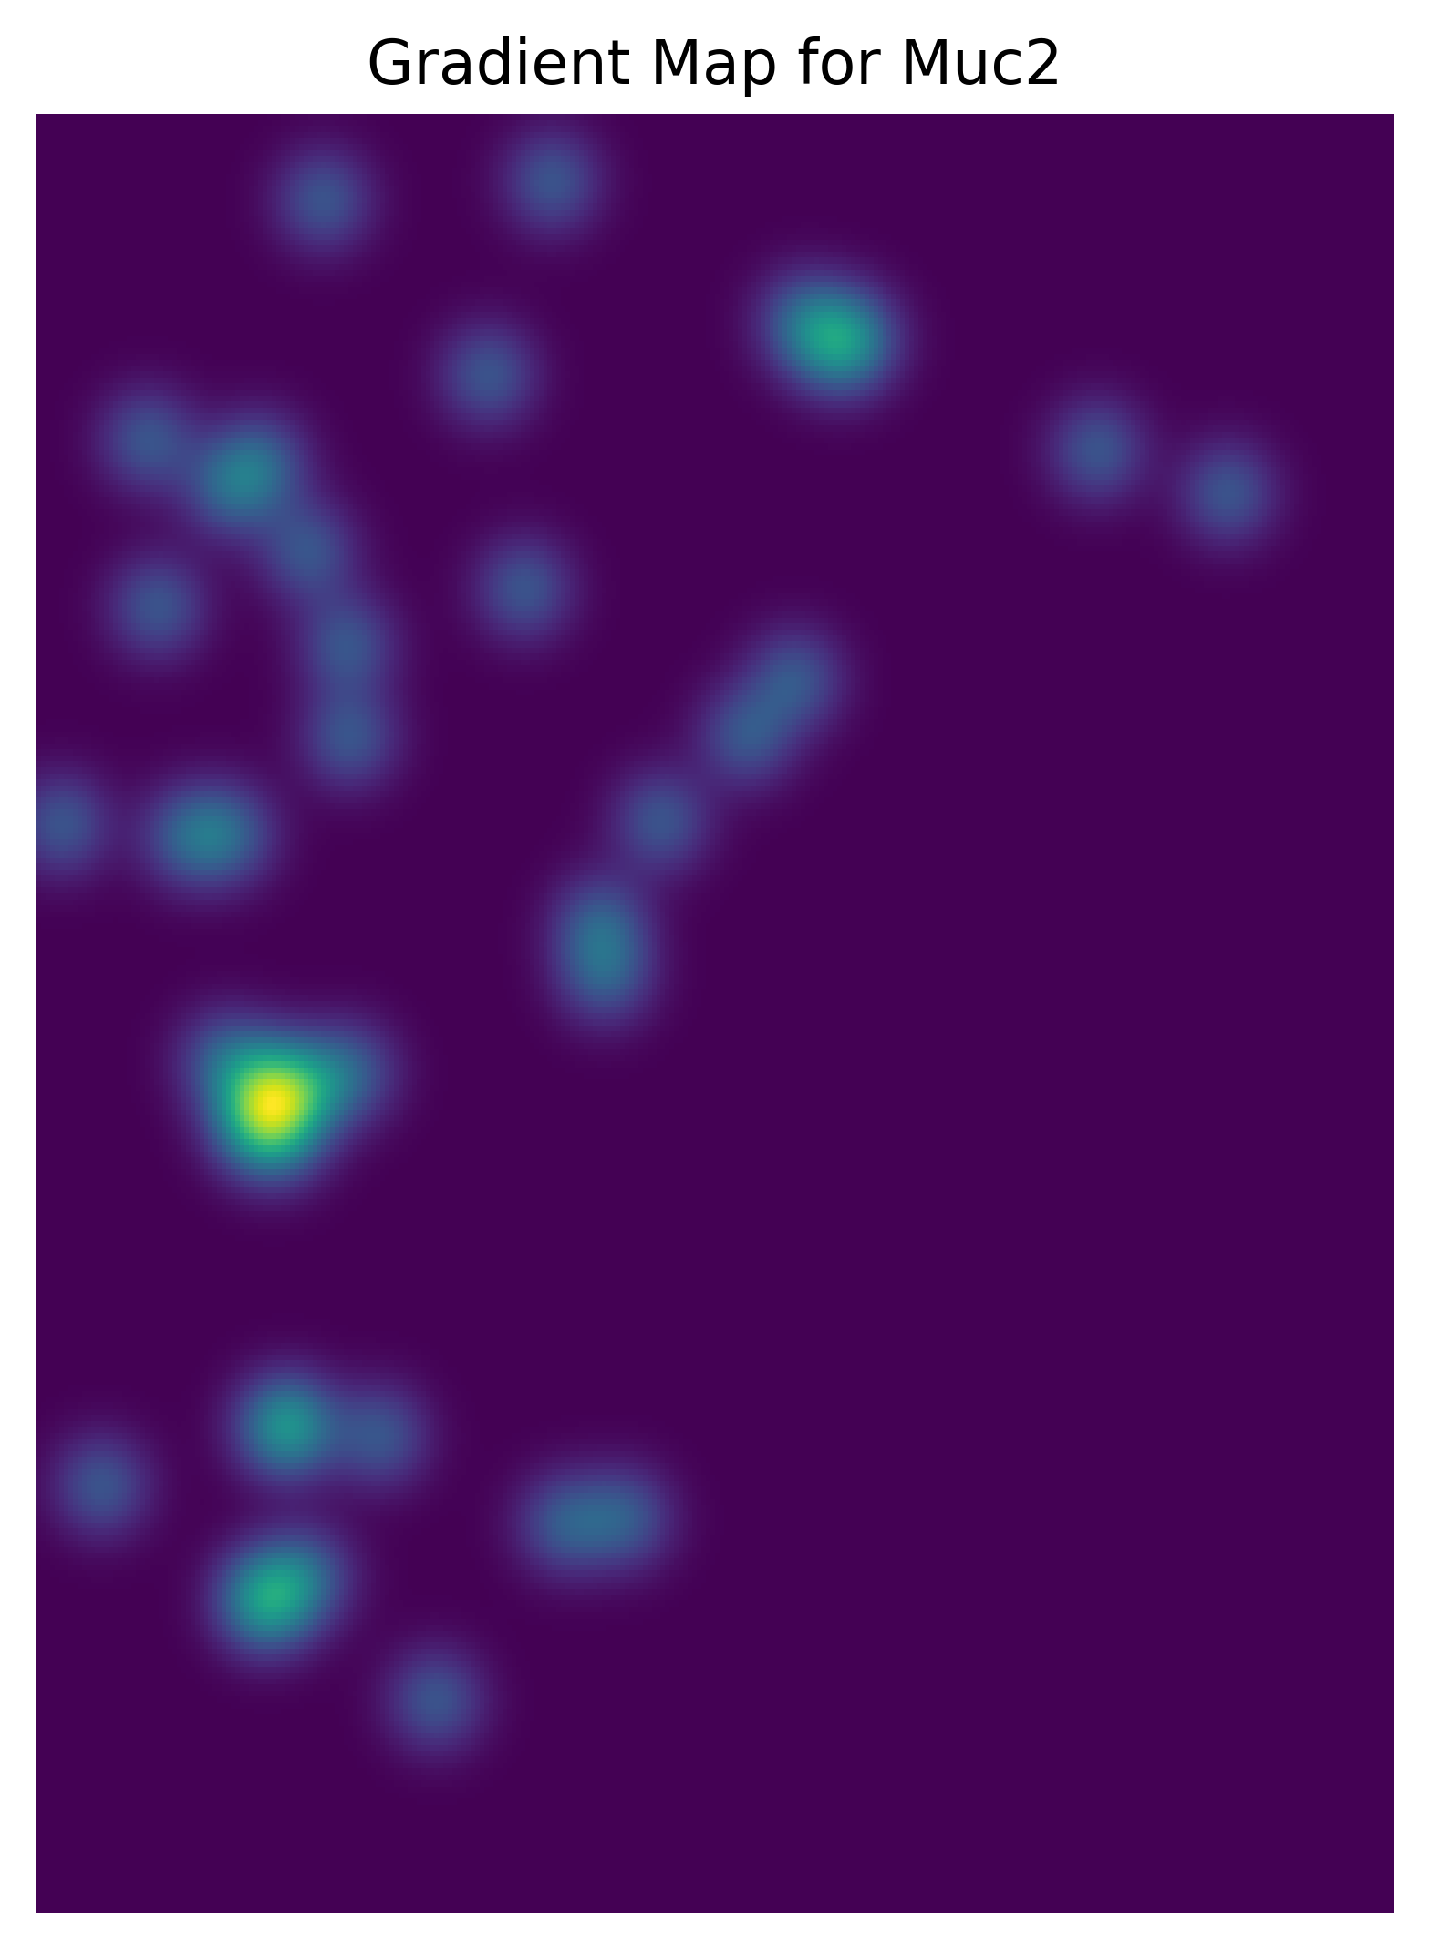
We can also use a kernel average neighboring spots to form an expression density map for each gene

Slide 9
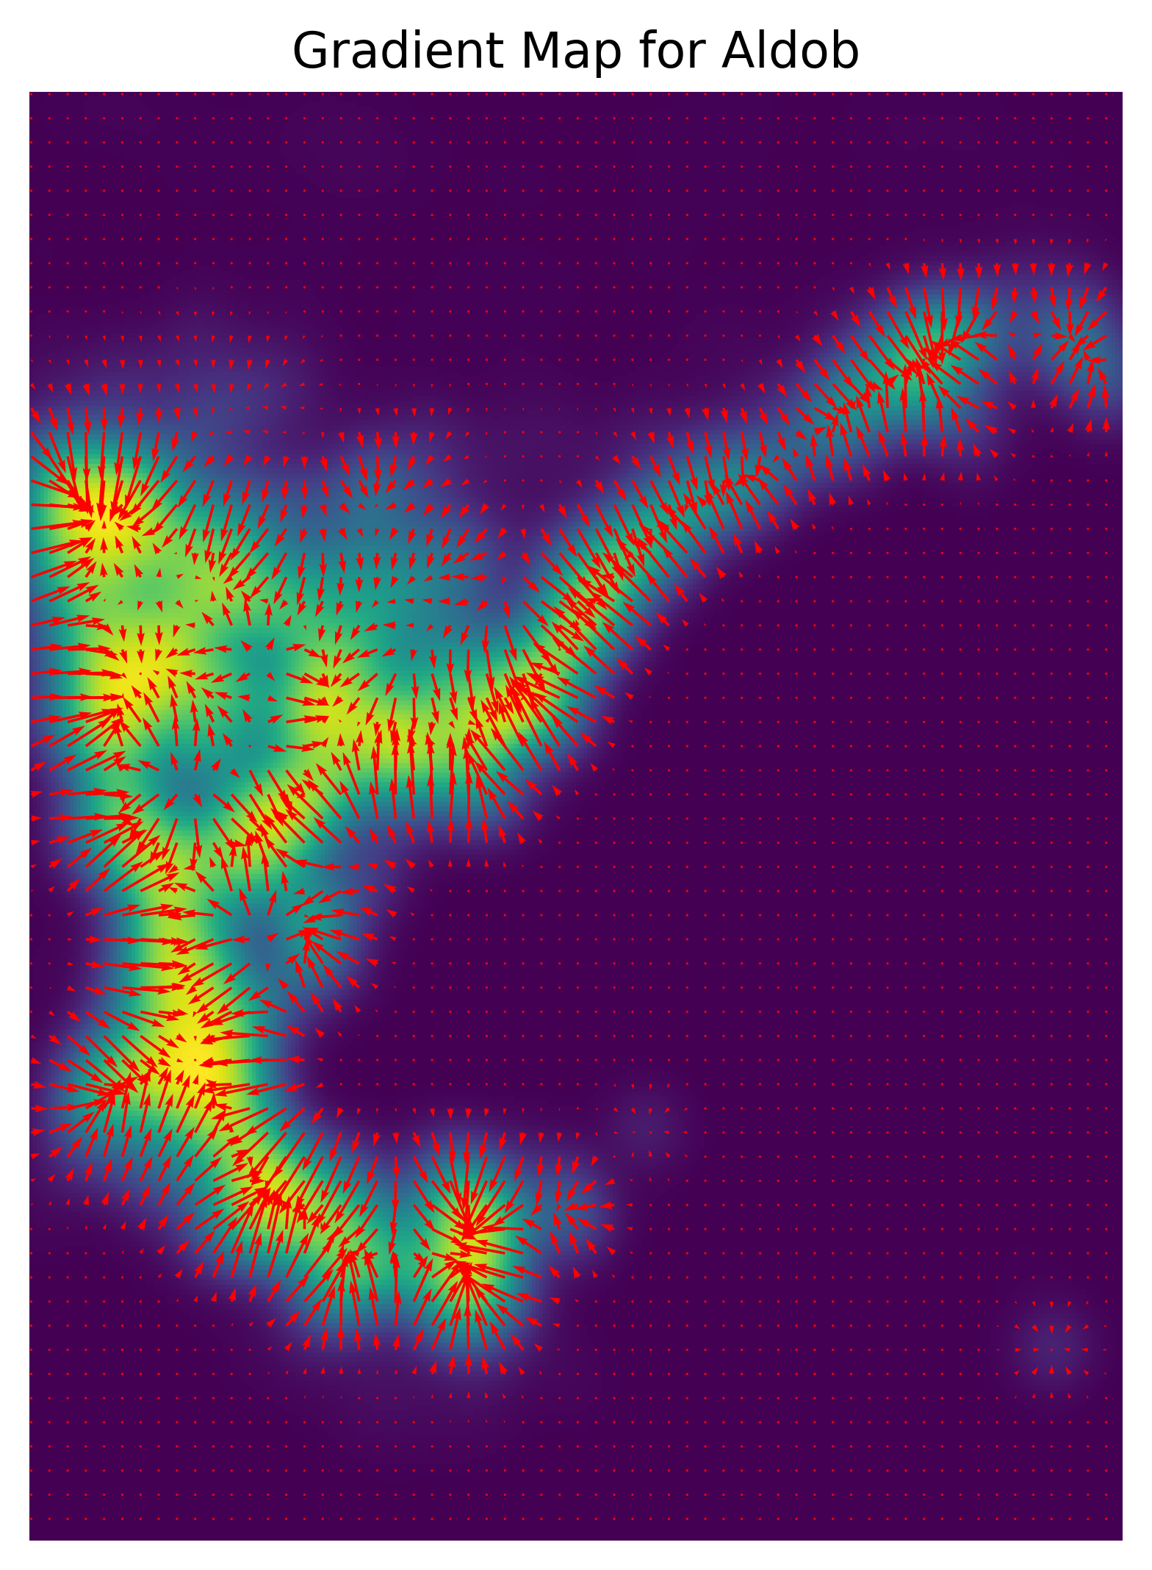
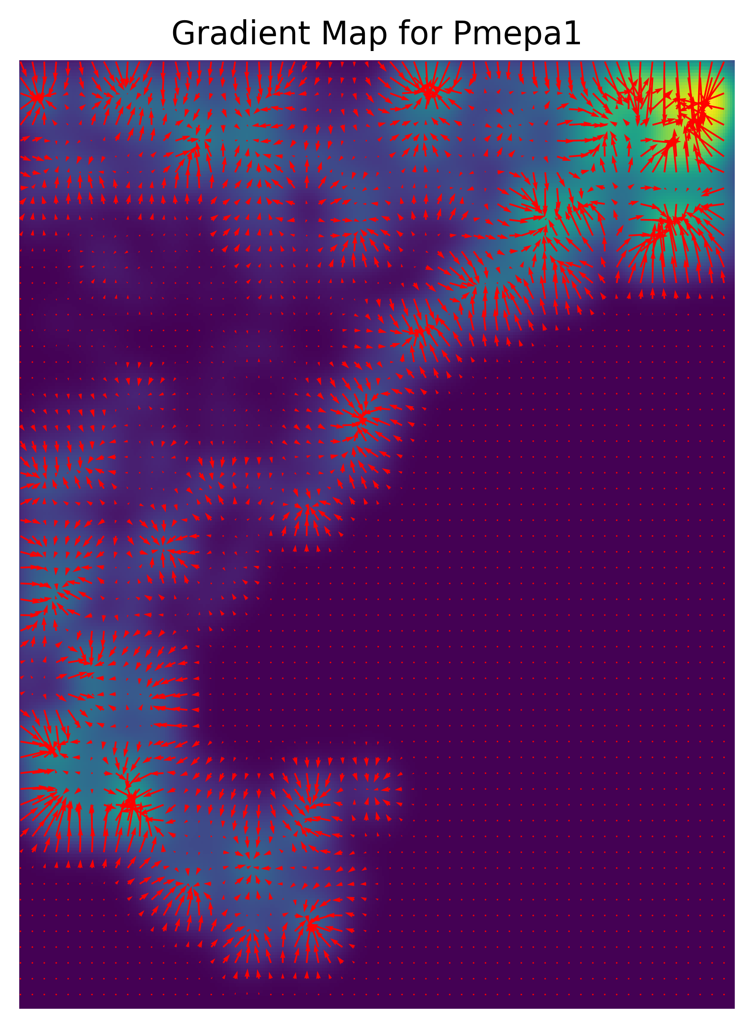
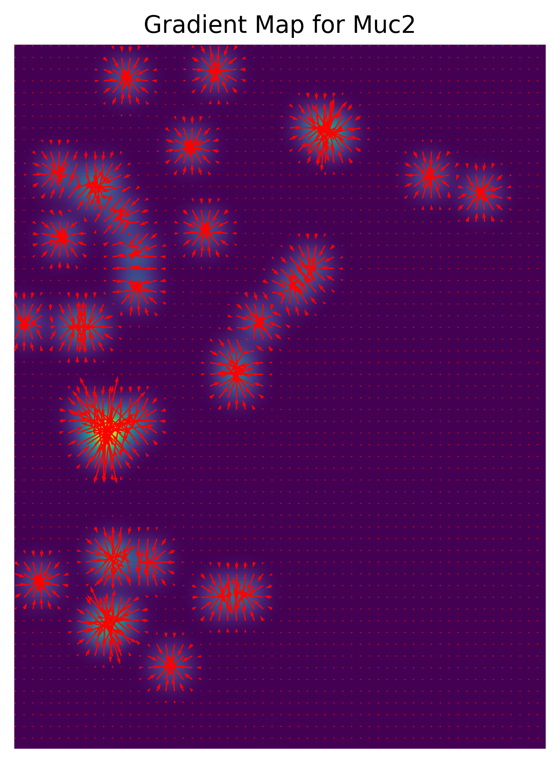
From density maps, we can calculate a gradient to identify where expression is changing

Slide 10
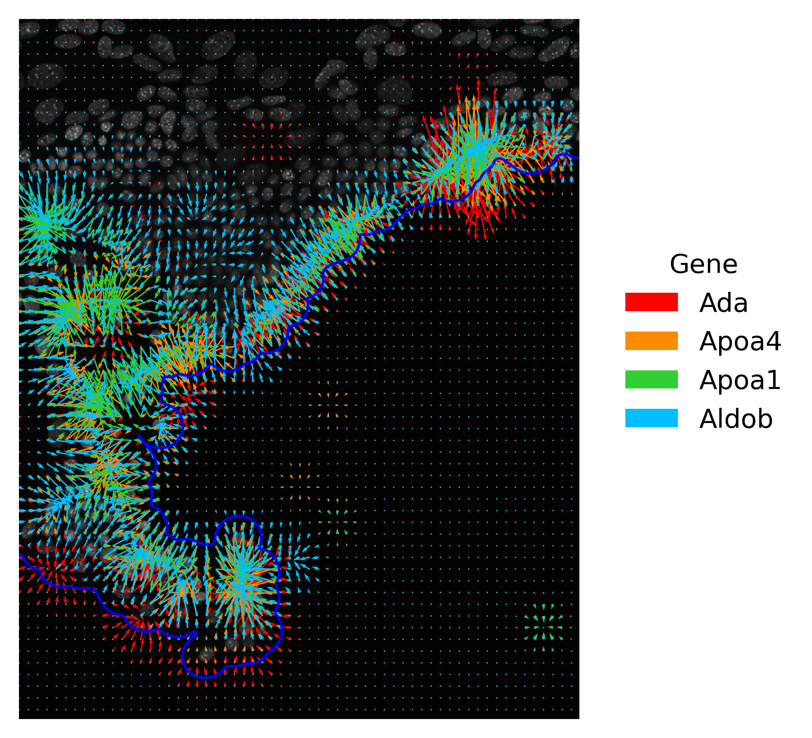
Can we identify genes that form zones parallel to the edge (as seen in enterocyte monolayers)?

Slide 11


We can use a dot product to calculate the alignment of the gene expression gradient to the monolayer
a
a
Dot Product = a cos(𝜃) * b
$$θ$$
$$θ$$
a_{x}
b
b
a_{x}
If parallel: Dot product = 1
If orthogonal: Dot product = 0

Slide 12
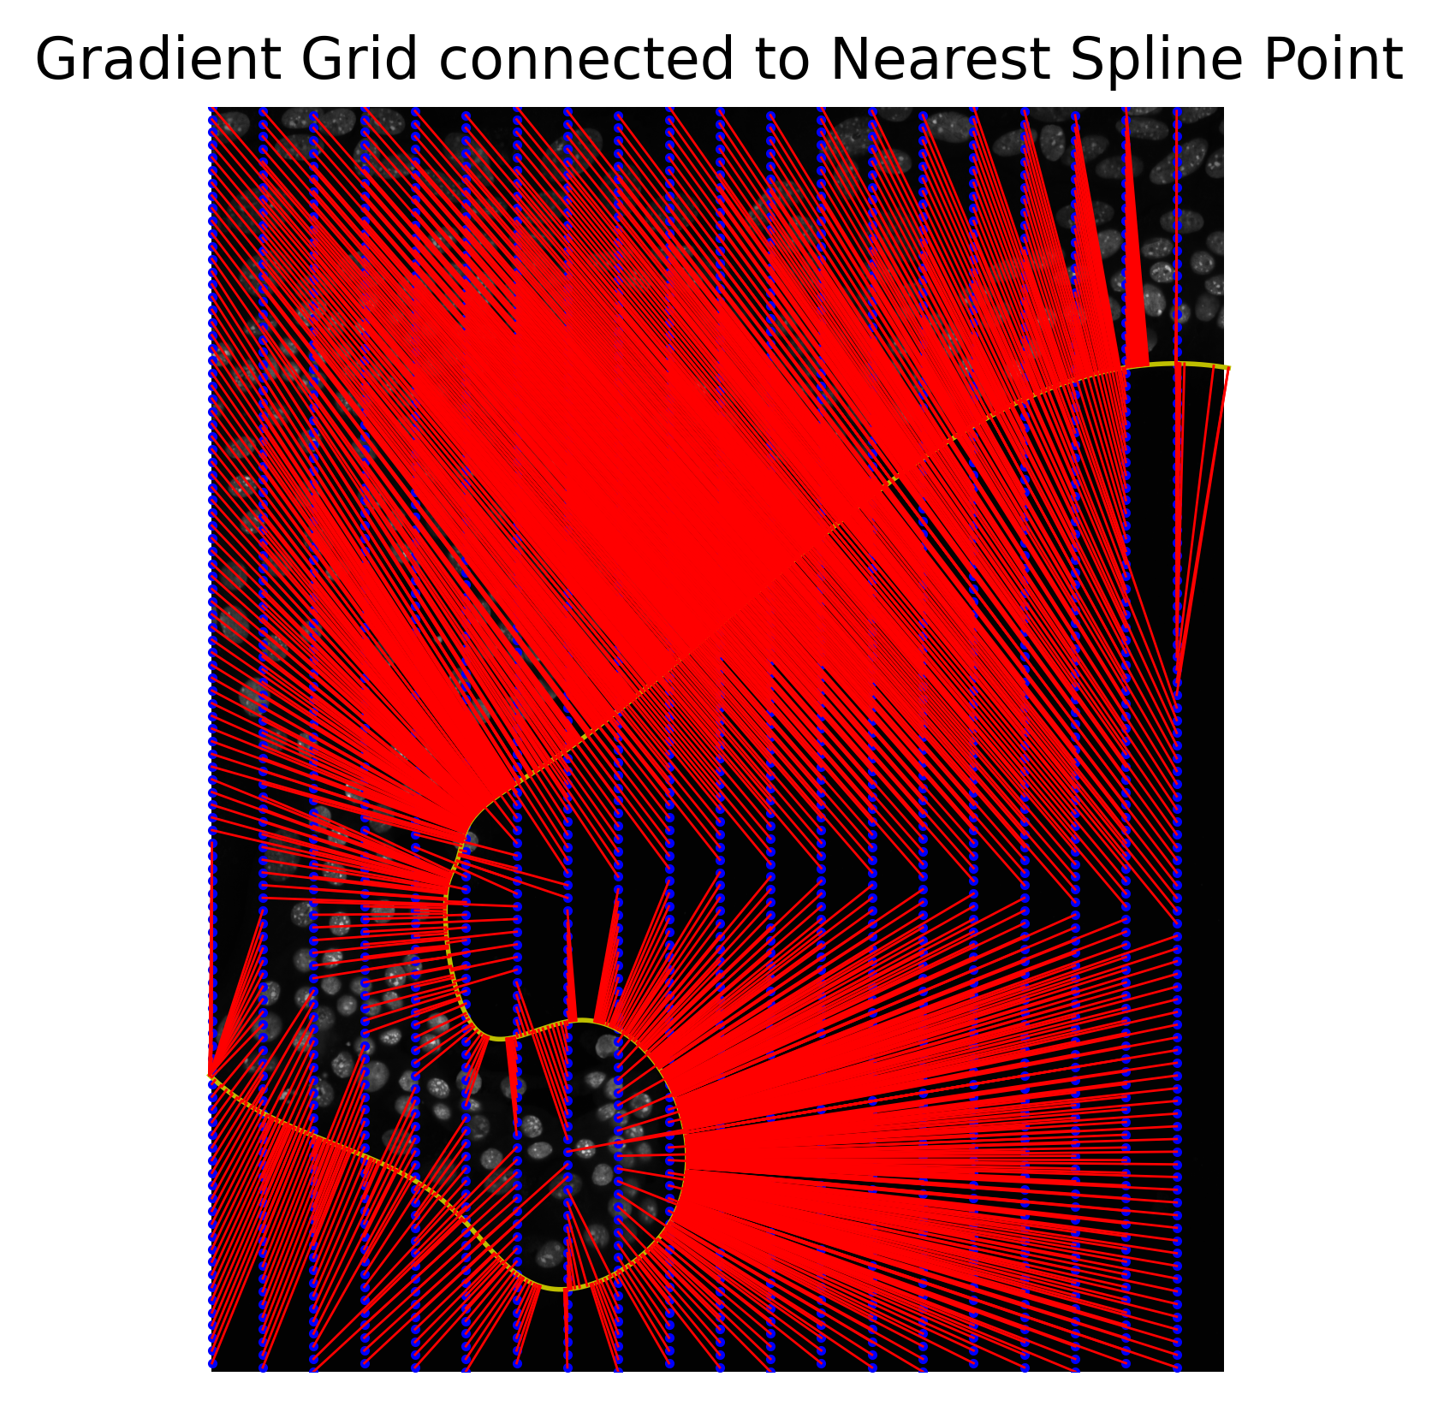
How do we decide what vectors to compare?

Slide 13
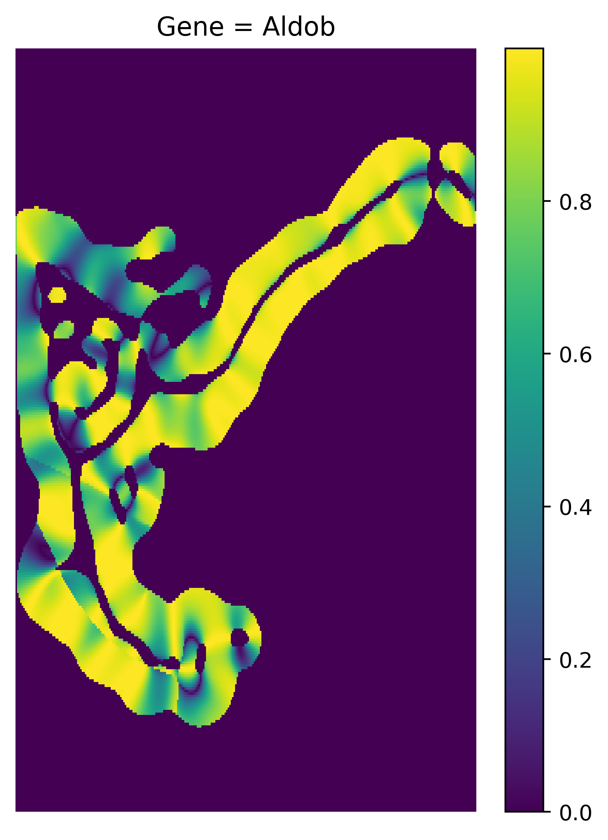
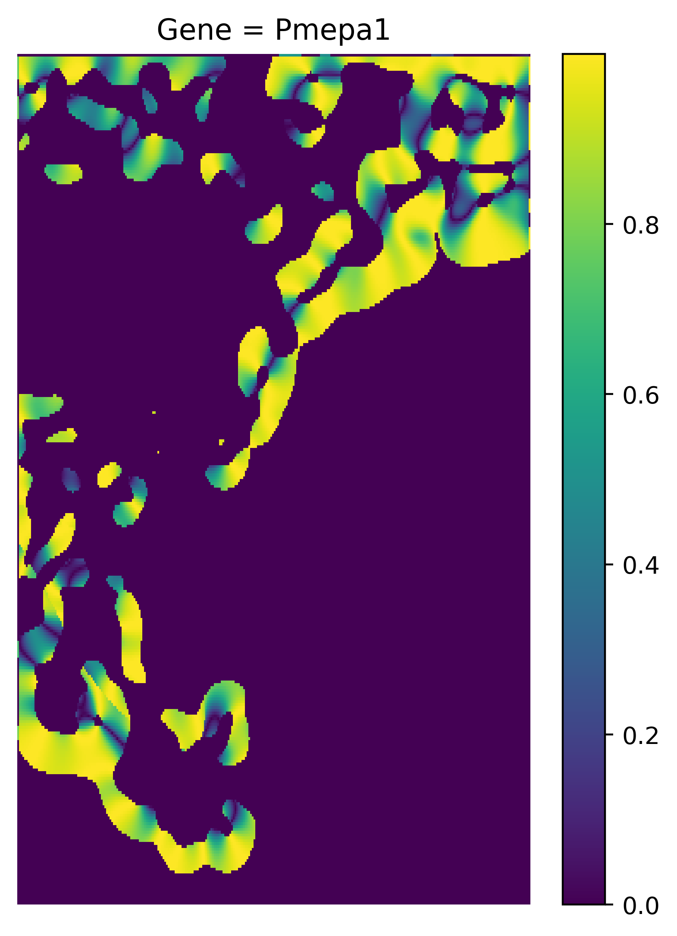
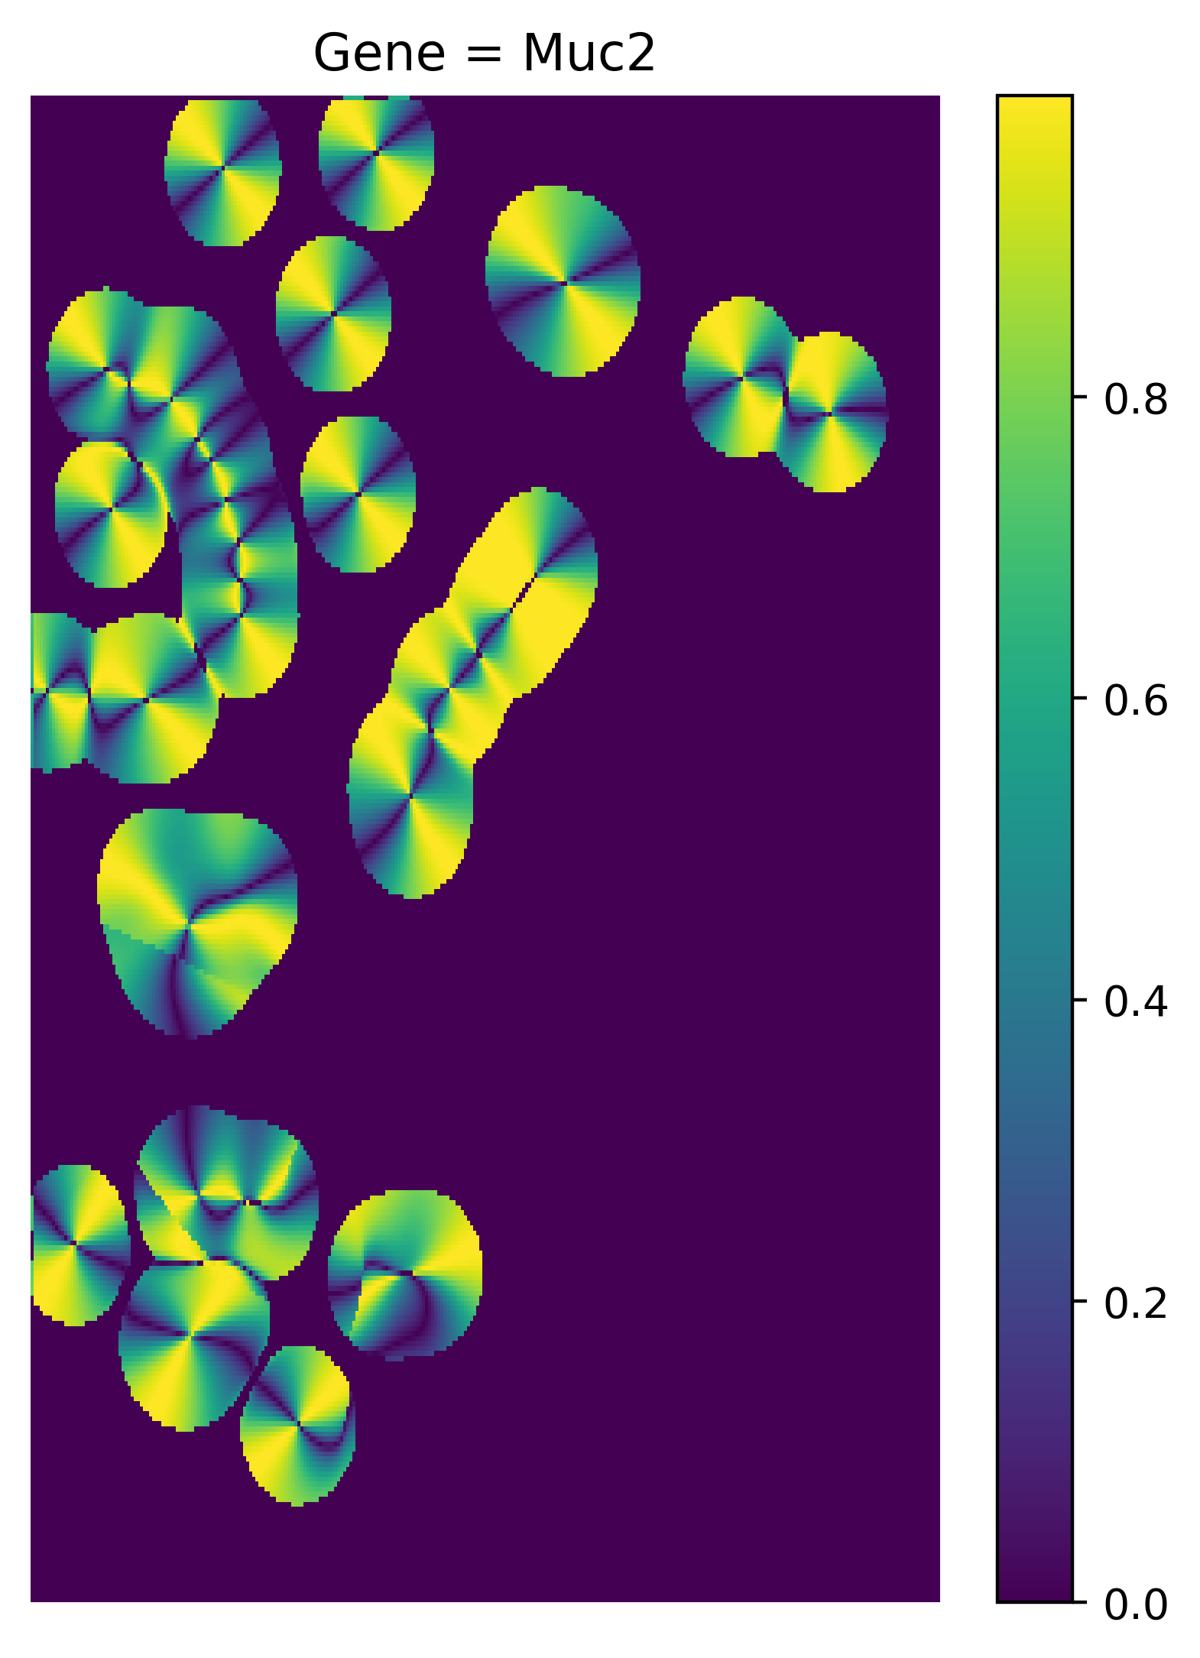
We can then calculate the alignment (where gradient > 0) for each gene

Slide 14
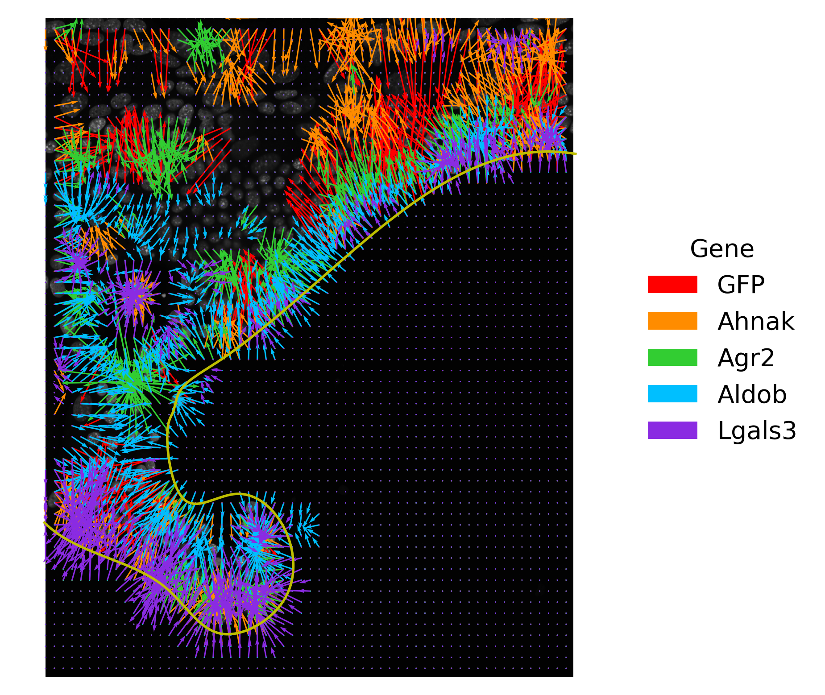
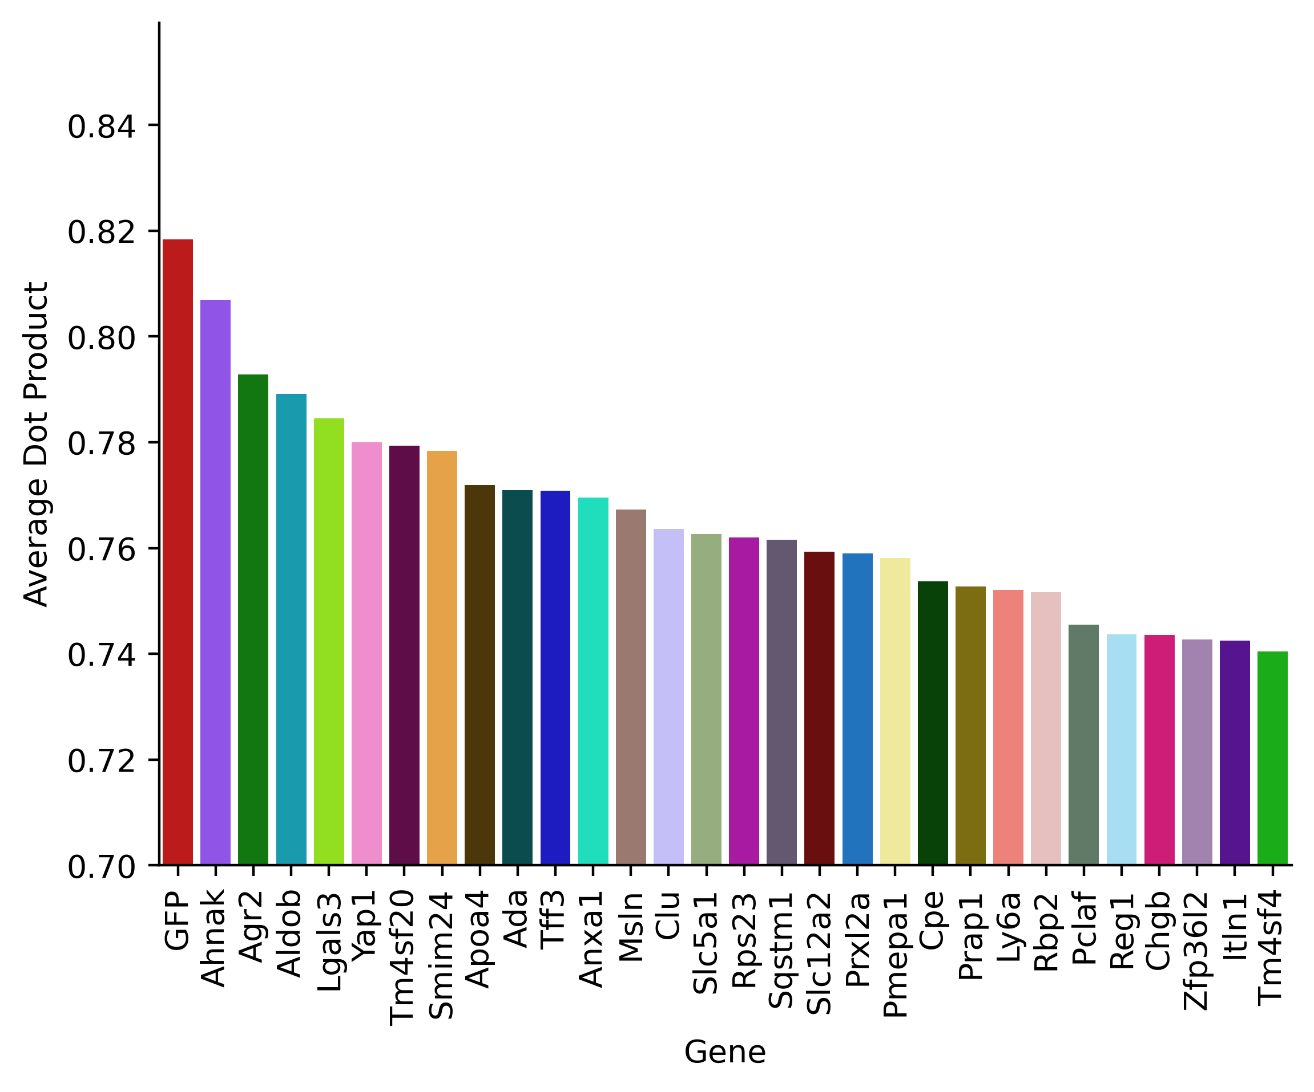
The top aligned genes contain known genes (Aldob, Apoa4) and some new ones

Slide 15
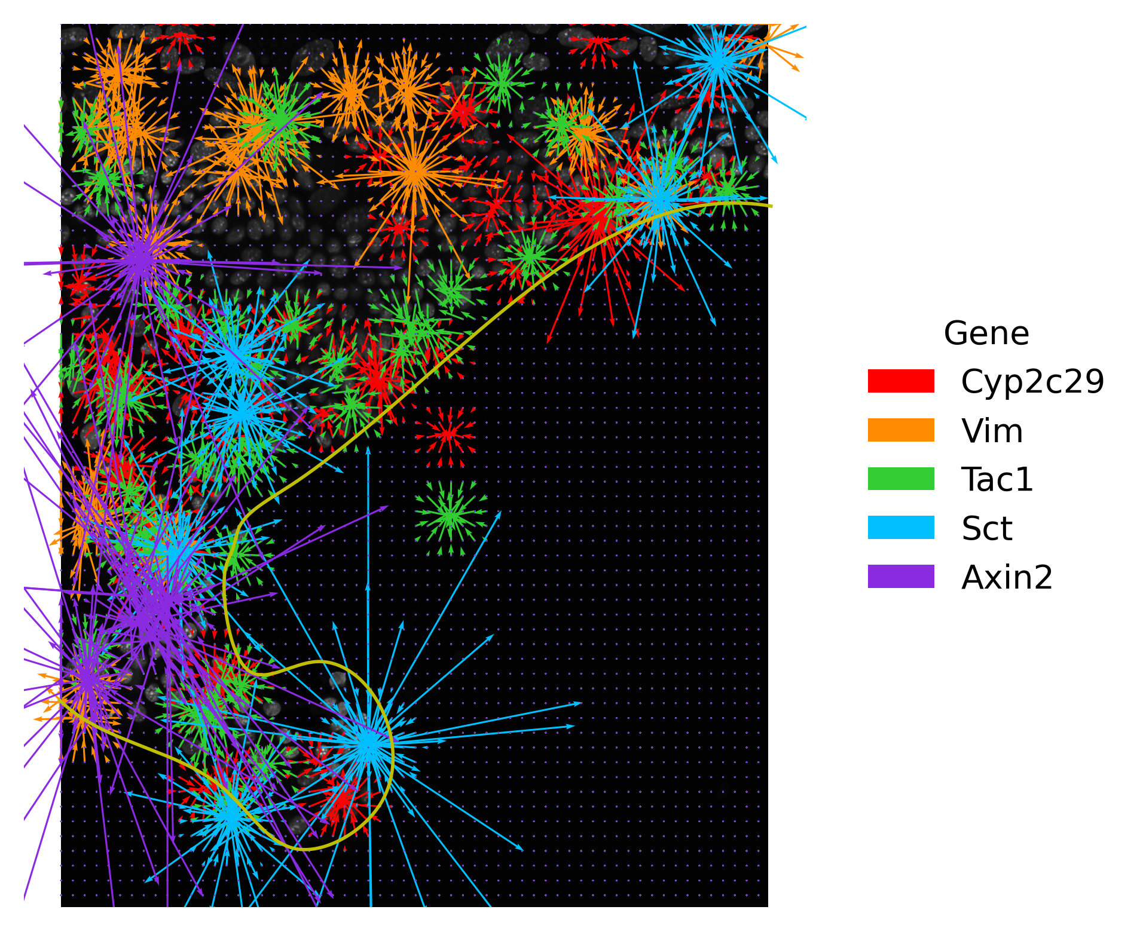
The least aligned genes show spot-like behavior

Slide 16
To continue quantifying spatial trends automatically, there are several next steps we could take
In a region highly enriched for zonated genes (based on alignment), which genes are located where?
What is the average distance from the gene’s highest expression to the line of demarcation?
If we calculate a profile of gene expression levels as a function of distance from the line of demarcation, in what order do we find these zonated genes peaked?
Can we use spatial gradients to identify which genes are cell type specific vs zonated?

Slide 17

Thank you!!
Arjun Raj
Miles Arnett
Vinay Ayyappan
Ryan Boe
Gianna Busch
Luciann Cuenca
Margaret Dunagin
Laura Van Eyndhoven
Caitlin Fagan
Xiangyi Fang
Yael Heyman
Naveen Jain
Grant Kinsler
Jessica Li
William Niu
Aoife O'Farrell
Pav Ravindran
Sam Reffsin
Cat Triandafillou
Sean Woo

